Slide 1


Python Programming Ⅰ
week 2

Slide 2
Python: Operators and Expressions
Notes:
안녕하세요, 송용욱입니다.
이 동영상에서는 ~을 주제로 배워 보겠습니다.

Slide 3
Topic Structure
Task | Single Value | Multiple Values | numpy, pandas
Presentation (value, variable) | int, float, string, boolean | list, tuple, dictionary, set | ndarray, Series, DataFrame
Operation (algebra) | expressions | operations, mutable operations | expressions, get, set, reshape, …
Control flow | if for while
Use and reuse | Functions Standard libraries Modules and Packages
Input and output | Standard I/O File I/O |  | Standard I/O File I/O CSV, Excel

Slide 4
Learning Objectives
Operators and Expressions
Arithmetic Operators
Relational Operators
Logical Operators
Shortcut for Math Operation and Assignment
Evaluation Order
Type Conversion

Slide 5
Operators and Expressions
A simple example of an ‘expression’ is 2 + 3.
An expression can be broken down into operators and operands.
‘Operators’ are functionality that do something and can be represented by symbols such as + or by special keywords.
Operators require some data to operate on and such data is called ‘operands’. In this case, 2 and 3 are the operands.

Slide 6
Operators and Expressions
Expression | 2 + 3 | -3
Operator | + | -
Operand(s) | 2, 3 | 3
 | * binary operator | * unary operator

Slide 7
Categories of Operators
Arithmetic Operators
+, -, *, /, …
Relational Operators
>, <, ==, …
Logical Operators
not, and, or

Slide 8
Learning Objectives
Operators and Expressions
Arithmetic Operators
Relational Operators
Logical Operators
Shortcut for Math Operation and Assignment
Evaluation Order
Type Conversion

Slide 9
Arithmetic Operators
+ (plus)
3 + 5 gives 8
'a' + 'b' gives 'ab'
- (minus)
-5.2 gives a negative number
50 - 24 gives 26
* (multiply)
2 * 3 gives 6
'la' * 3 gives 'lalala‘
** (power)
3 ** 4 gives 81
/ (divide)
13 / 3 gives 4.333333333333333
// (divide and floor, quotient)
13 // 3 gives 4
-13 // 3 gives -5
9 // 1.81 gives 4.0
% (modulo)
13 % 3 gives 1
-25.5 % 2.25 gives 1.5

Slide 10
Example: plus
print(3 + 5)
print('a' + 'b')
print(+2)
A = 3
B = 5
print(A + B)
A = 'a'
B = 'b'
print(A + B)
A = 2
print(+A)

Slide 11
Example: minus
print(-5.2)
print(50 - 24)
A = 5.2
print(-A)
A = 50
B = 24
print(A - B)

Slide 12
Example: multiply
print(2 * 3)
print('la' * 3)
A = 2
B = 3
print(A * B)
A = 'la'
B = 3
print(A * B)

Slide 13
Example: power
print(3 ** 4)
A = 3
B = 4
print(A ** B)

Slide 14
Example: divide
print(13 / 3)
A = 13
B = 3
print(A / B)

Slide 15
Example: divide and floor (quotient)
print(13 // 3)
print(-13 // 3)
print(9 // 1.81)
A = 13
B = 3
print(A // B)
A = -13
B = 3
print(A // B) # -4.3333
A = 9
B = 1.81
print(A // B) # 4.972

Slide 16
Example: modulo
print(13 % 3)
print(-25.5 % 2.25)
A = 13
B = 3
print(A % B) # 13-12
A = -25.5
B = 2.25
print(A % B)
# (2.25 * 12.0) - 25.5

Slide 17
Example: odd or even
1 % 2 == 1
2 % 2 == 0
3 % 2 == 1
4 % 2 == 0
5 % 2 == 1
…
print(1 % 2)
print(2 % 2)
print(3 % 2)
print(4 % 2)
print(5 % 2)
print(6 % 2)
print(7 % 2)
print(8 % 2)
print(9 % 2)
print(10 % 2)

Slide 18
Example: divide evenly
When X divides Y evenly,
Y % X == 0
print(121 % 11)

Slide 19
Bit-wise Operators (pass)
<< (left shift)
>> (right shift)
& (bit-wise AND)
| (bit-wise OR)
^ (bit-wise XOR)
~ (bit-wise invert)

Slide 20
Learning Objectives
Operators and Expressions
Arithmetic Operators
Relational Operators
Logical Operators
Shortcut for Math Operation and Assignment
Evaluation Order
Type Conversion

Slide 21
Relational Operators
< (less than)
5 < 3 gives False
3 < 5 gives True
Comparisons can be chained arbitrarily: 3 < 5 < 7 gives True.
If both operands are numbers, they are first converted to a common type. Otherwise, it always returns False.
> (greater than)
5 > 3 returns True
<= (less than or equal to)
x = 3; y = 6; x <= y returns True
>= (greater than or equal to)
x = 4; y = 3; x >= 3 returns True
== (equal to)
x = 2; y = 2; x == y returns True
x = 'str'; y = 'stR'; x == y returns False
x = 'str'; y = 'str'; x == y returns True
!= (not equal to)
x = 2; y = 3; x != y returns True

Slide 22
Example: less than
print(5 < 3)
print(3 < 5)
print(3 < 5 < 7)
A = 3
B = 5
C = 7
print(B < A)
print(A < B)
print(A < B < C)
print("5 < 3", 5 < 3)
print("3 < 5", 3 < 5)
print("3 < 5 < 7", 3 < 5 < 7)
A = 3
B = 5
C = 7
print("B < A", B < A)
print("A < B", A < B)
print("A < B < C", A < B < C)

Slide 23
Example: greater than
print(5 > 3)
print(3 > 5)
print(3 > 5 > 7)
A = 3
B = 5
C = 7
print(B > A)
print(A > B)
print(A > B > C)
print("5 > 3", 5 > 3)
print("3 > 5", 3 > 5)
print("3 > 5 > 7", 3 > 5 > 7)
A = 3
B = 5
C = 7
print("B > A", B > A)
print("A > B", A > B)
print("A > B > C", A > B > C)

Slide 24
Example: less than or equal to
x = 3
y = 6
print(x <= y)
x = 3
y = 6
print("x <= y", x <= y)

Slide 25
Example: greater than or equal to
x = 4
y = 3
print(x >= 3)
x = 4
y = 3
print("x >= 3", x >= 3)

Slide 26
Numeric Order vs. Lexicographical Order
Numeric Order
1, 2, 11
1, 11, 2 # ?
Lexicographical Order
A, B, AA # ?
A, AA, B
사전 단어 찾기
도서관 책 찾기
청구기호: 005.133P 001a
print(1 < 2) # T
print(2 < 11) # T
print("A" < "B") # T
print("B" < "AA") # F

Slide 27
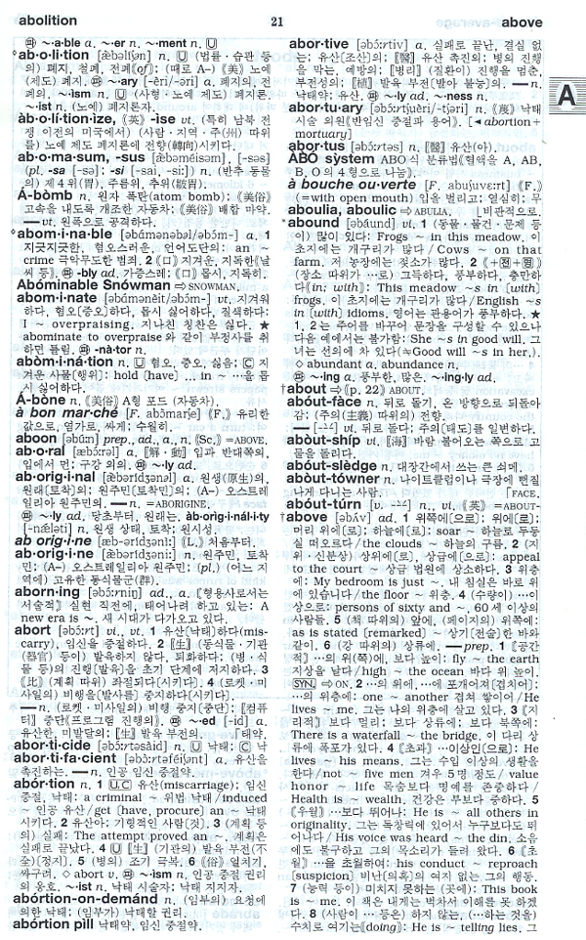
Lexicographical Order: English-Korean Dictionary (엣센스 영한사전)
https://eltdb.com/shop2/prodimg/05/02/ESSEK21.jpg

Slide 28
Example: equal to
x = 2
y = 2
print(x == y)
x = 'str'
y = 'stR'
print(x == y)
print(x.lower() == y.lower())
print(x.upper() == y.upper())
x = 'str'
y = 'str'
print(x == y)
x = 2
y = 2
print("x == y", x == y)
x = 'str'
y = 'stR'
print("x == y", x == y)
print("x.lower() == y.lower()", x.lower() == y.lower())
x = 'str'
y = 'str'
print("x == y", x == y)

Slide 29
Example: not equal to
x = 2
y = 2
print(x != y)
x = 'str'
y = 'stR'
print(x != y)
print(x.lower() != y.lower())
print(x.upper() != y.upper())
x = 'str'
y = 'str'
print(x != y)
x = 2
y = 2
print("x != y", x != y)
x = 'str'
y = 'stR'
print("x != y", x != y)
print("x.lower() != y.lower()", x.lower() != y.lower())
x = 'str'
y = 'str'
print("x != y", x != y)

Slide 30
Learning Objectives
Operators and Expressions
Arithmetic Operators
Relational Operators
Logical Operators
Shortcut for Math Operation and Assignment
Evaluation Order
Type Conversion

Slide 31
Logical Operators
not (Boolean NOT)
If x is True, it returns False. If x is False, it returns True.
x = True; not x returns False.
and (Boolean AND)
x and y returns False if x is False, else it returns evaluation of y
x = False; y = True; x and y returns False since x is False. In this case, Python will not evaluate y since it knows that the left hand side of the 'and' expression is False which implies that the whole expression will be False irrespective of the other values. This is called short-circuit evaluation.
or (Boolean OR)
If x is True, it returns True, else it returns evaluation of y
x = True; y = False; x or y returns True. Short-circuit evaluation applies here as well.

Slide 32
Example: not
x = True
print(not x)
x = False
print(not x)
A = 2
B = 2
x = A == B
x = (A == B)
print(not x)
x = A > B
x = (A > B)
print(not x)

Slide 33
Example: and
x = False
y = 1
print(x and y)
x = True
y = 1
print(x and y)
A = 3
B = 2
x = (A == B)
y = (A > B)
print(x and y)
x = (A > B)
y = 1
print(x and y)

Slide 34
Example: or
x = True
y = 1
print(x or y)
x = False
y = 1
print(x or y)
A = 3
B = 2
x = (A > B)
y = 1
print(x or y)
x = (A == B)
y = (A > B)
print(x or y)

Slide 35
Learning Objectives
Operators and Expressions
Arithmetic Operators
Relational Operators
Logical Operators
Shortcut for Math Operation and Assignment
Evaluation Order
Type Conversion

Slide 36
Shortcut for Math Operation and Assignment
It is common to run a math operation on a variable and then assign the result of the operation back to the variable, hence there is a shortcut for such expressions:
a = 2
a = a * 3
can be written as:
a = 2
a *= 3
Notice that ‘var = var operation’ expression becomes ‘var operation= expression’.

Slide 37
Example: Shortcut for + and Assignment
a = 2
a = a + 3
print(a)
a = 2
a += 3
print(a)

Slide 38
Example: Shortcut for - and Assignment
a = 2
a = a - 3
print(a)
a = 2
a -= 3
print(a)

Slide 39
Example: Shortcut for * and Assignment
a = 2
a = a * 3
print(a)
a = 2
a *= 3
print(a)

Slide 40
Example: Shortcut for / and Assignment
a = 2
a = a / 3
print(a)
a = 2
a /= 3
print(a)

Slide 41
Example: Shortcut for % and Assignment
a = 2
a = a % 3
print(a)
a = 2
a %= 3
print(a)

Slide 42
Learning Objectives
Operators and Expressions
Arithmetic Operators
Relational Operators
Logical Operators
Shortcut for Math Operation and Assignment
Evaluation Order
Type Conversion

Slide 43
Evaluation Order (lower to higher)
Operators | Description
Lambda | Lambda Expression
if – else | Conditional expression
or | Boolean OR
and | Boolean AND
not x | Boolean NOT
in, not in, is, is not, <, <=, >, >=, !=, == | Comparisons, including membership tests and identity tests
| | Bitwise OR
^ | Bitwise XOR
& | Bitwise AND
<<, >> | Shifts
+, - | Addition and subtraction
*, /, //, % | Multiplication, Division, Floor Division and Remainder
+x, -x, ~x | Positive, Negative, bitwise NOT
** | Exponentiation
x[index], x[index:index], x(arguments...), x.attribute | Subscription, slicing, call, attribute reference
(expressions...), [expressions...], {key: value...}, {expressions...} | Binding or tuple display, list display, dictionary display, set display

Slide 44
Example: Evaluation Order
print(2 + 3 * 4)
print(2 + 3 * 4 - 5)
print(2 - 5 + 3 * 4)

Slide 45
Example: Evaluation Order
print(not 3 < 4 and 12 + 6 > 23 or 123 < 34 ** 2)
# Note: Numbers not zero are equal to True
# Java: print((not 3) < 4 and 12 + 6 > 23 or 123 < 34 ** 2)
print(not (3 < 4) and (12 + 6) > 23 or 123 < (34 ** 2))
print((not (3 < 4)) and ((12 + 6) > 23) or (123 < (34 ** 2)))
print(((not (3 < 4)) and ((12 + 6) > 23)) or (123 < (34 ** 2)))

Slide 46
Changing the Order Of Evaluation
To make the expressions more readable, we can use parentheses.
For example, ‘2 + (3 * 4)’ is definitely easier to understand than ‘2 + 3 * 4’ which requires knowledge of the operator precedence.
There is an additional advantage to using parentheses - it helps us to change the order of evaluation.
For example, if you want addition to be evaluated before multiplication in an expression, then you can write something like ‘(2 + 3) * 4’.

Slide 47
Example: Changing the Order Of Evaluation
print((2 + 3) * 4)
print((2 + 3) * 4 - 5)
print((2 - 5 + 3) * 4)

Slide 48
Associativity
Operators are usually associated from left to right.
This means that operators with the same precedence are evaluated in a left to right manner.
For example, 2 - 3 + 4 is evaluated as (2 - 3) + 4.

Slide 49
Example: Associativity – Left to Right
# + and - have the same precedence
print(2 - 3 + 4)
# Which one is equivalent to the expression above?
print(2 - (3 + 4))
print((2 - 3) + 4)

Slide 50
Example: Associativity – Right to Left
print(2 ** 3 ** 4)
print(2 ** (3 ** 4))
print((2 ** 3) ** 4)

Slide 51
Example: Area, Perimeter, Volume
iLength = 5
iBreadth = 2
iDepth = 4
print('Area is', iLength * iBreadth)
print('Perimeter is', 2 * (iLength + iBreadth))
print('Volume is', iLength * iBreadth * iDepth)

Slide 52
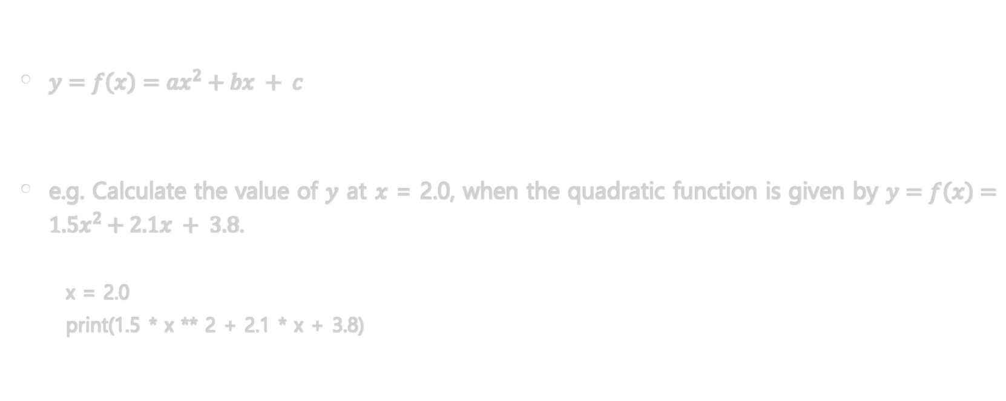
Example: Quadratic Functions
$y=f\left(x\right)=ax^{2}+bx + c$
e.g. Calculate the value of $y$ at $x$ = 2.0, when the quadratic function is given by $y=f\left(x\right)=1.5x^{2}+2.1x + 3.8$.
x = 2.0
print(1.5 * x ** 2 + 2.1 * x + 3.8)

Slide 53
Learning Objectives
Operators and Expressions
Arithmetic Operators
Relational Operators
Logical Operators
Shortcut for Math Operation and Assignment
Evaluation Order
Type Conversion

Slide 54
Type Conversion
Float to int
e.g. int(1.5)
String to int
e.g. int("12")
String to float
e.g. float("1.5")
Float, int to string
e.g. str(1.23)
e.g. "{0:d}".format(123)
e.g. "{0:.2f}".format(123.123)

Slide 55
Example: Float to int – round-off, round-down, round-up
Round-off
A = 1.5
print(int(A + 0.5)) # 2
A = -1.5
print(int(A + 0.5)) # -1
Rounding off a number to two decimal places
A = 1.125
B = int((A * 100 + 0.5)) / 100
print(B) # 1.13
Round-down
print(int(1.5)) # 1
print(int(-1.5)) # -1 → -2?
Round-up
print(int(1.5 + 1.0)) # 2
print(int(3.0 + 1.0)) # 4 → 3?

Slide 56
Example: round( )
round(number[, ndigits]) return number rounded to ndigits precision after the decimal point.
If ndigits is omitted or is None, it returns the nearest integer to its input.
print(round(1.5)) # 2
print(round(1.115, 2)) # 1.11 → 1.12?
print(round(1115, -2)) # 1100
print(round(2.5)) # 2 → 3?

Slide 57
Rounding to the nearest integer
-2.5
-1.5
1.5
2.5
-3
-2
-1
0
1
2
3
Commonly,
1.3 → 1 1.7 → 2
-1.3 → -1 -1.7 → -2
Round half up (in Math class)
1.5 → 2 2.5 → 3
-1.5 → -1 -2.5 → -2
Round half down
1.5 → 1 2.5 → 2
-1.5 → -2 -2.5 → -3
Round half towards zero
1.5 → 1 2.5 → 2
-1.5 → -1 -2.5 → -2
Round half away from zero
1.5 → 2 2.5 → 3
-1.5 → -2 -2.5 → -3
Round half to even (in Python)
1.5 → 2 2.5 → 2
-1.5 → -2 -2.5 → -2
Round half to odd
1.5 → 1 2.5 → 3
-1.5 → -1 -2.5 → -3

Slide 58
Rounding to the nearest integer in Python
print(round(1.5)) # 2
print(round(2.5)) # 2
print(round(2.7)) # 3
print(round(-1.5)) # -2
print(round(-2.5)) # -2
print(round(-2.7)) # -3

Slide 59
Example: math.floor( )
math.floor(x) returns the largest integer value less than or equal to x.
import math
print(math.floor(1.5)) # 1
print(math.floor(2.5)) # 2
print(math.floor(3.0)) # 3
print(math.floor(-1.5)) # -2
print(math.floor(-2.5)) # -3
print(math.floor(-3.0)) # -3

Slide 60
Example: math.ceil( )
math.ceil(x) returns the smallest integer value greater than or equal to x.
import math
print(math.ceil(1.5)) # 2
print(math.ceil(2.5)) # 3
print(math.ceil(3.0)) # 3
print(math.ceil(-1.5)) # -1
print(math.ceil(-2.5)) # -2
print(math.ceil(-3.0)) # -3

Slide 61
Rounding Summary
Round-off
Use ‘adding 0.5’ operation
Round-down
Use math.floor()
Round-up
Use math.ceil()

Slide 62
Example: String to int
print(int("12"))
print(int("12") + 1.5)

Slide 63
Example: String to float
print(float("1.5"))
print(float("1.5") + 1.5)

Slide 64
Example: Float, int to string
s = str(1.23)
print(s * 3)
s = "{0:d}".format(123)
print(s * 3)
s = "{0:.2f}".format(123.123)
print(s * 3)

Slide 65
생각할 점
Topic
int( ) 함수를 사용하여 100의 자리에서 반올림하는 방법을 설명하시오. 예를 들어, 2354를 100의 자리에서 반올림하면 2400이 됩니다.
Objective
내림과 0.5를 사용하여 반올림하는 방법을 숙지한다.
Notes:
오프라인 수업에서는, 이 슬라이드에 나타난 하브루타를, 진행하겠습니다.
학생들은, 미리 준비한 후, 수업에 들어오기 바랍니다.

Slide 66
Summary
Operators and Expressions
Arithmetic Operators
Relational Operators
Logical Operators
Shortcut for Math Operation and Assignment
Evaluation Order
Type Conversion

Slide 67

End of Week.02 Python: Operators and Expressions

